Slide 1

Cognitive Psychology
http://compcogscisydney.org/psyc2071/
A/Prof Danielle Navarro
d.navarro@unsw.edu.au
compcogscisydney.org
Research interests: human learning, reasoning, induction, decision making, computational modelling, statistics

Slide 2
Close your eyes and imagine flipping a fair coin 5 times in a row… and remember the outcomes
(yes, I know you have the slides and can jump ahead, but why break the demo?)

Slide 3
There are 32 possible responses, each of which should be equally likely, right?
TTTTT
HHHHH
THTTT
HTHHH
TTTTH
HHHHT
THTTH
HTHHT
TTTHT
HHHTH
THTHT
HTHTH
TTTHH
HHHTT
THTHH
HTHTT
TTHTT
HHTHH
THHTT
HTTHH
TTHTH
HHTHT
THHTH
HTTHT
TTHHT
HHTTH
THHHT
HTTTH
TTHHH
HHTTT
THHHH
HTTTT

Slide 4
Did you pick one of these?
THTTT
HTHHH
TTTTH
HHHHT
TTTHT
HHHTH
THTHT
HTHTH
TTTHH
HHHTT
TTHTT
HHTHH
TTHHH
HHTTT
THHHH
HTTTT

Slide 5
How about these?
THTTH
HTHHT
THTHH
HTHTT
THHTT
HTTHH
TTHTH
HHTHT
THHTH
HTTHT
TTHHT
HHTTH
THHHT
HTTTH

Slide 6
How many people picked one of these?
TTTTT
HHHHH
… and did you do this because you thought it was a trick question?

Slide 7
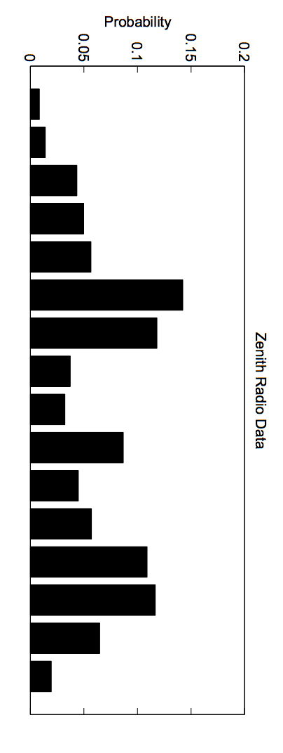
TTTTT
HHHHH
TTTTH
HHHHT
TTTHT
HHHTH
TTTHH
HHHTT
TTHTT
HHTHH
TTHTH
HHTHT
Zenith radio data: 20,099 people calling into a radio station to test their psychic powers by predicting a random sequence of outcomes
TTHHT
HHTTH
TTHHH
or
HHTTT
THTTT
HTHHH
THTTH
HTHHT
THTHT
HTHTH
THTHH
HTHTT
THHTT
HTTHH
THHTH
HTTHT
THHHT
HTTTH
THHHH
HTTTT
Goodfellow (1938)

Slide 8
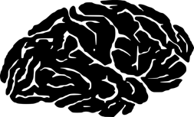

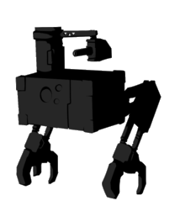
Cognitive Psychology
Part 1: Navarro
L1: Introduction
L2: Attention
L3: Similarity
L4: Reasoning
L5: A case study
L6: Q&A, recap, etc
Part 2: Taft
Propositional knowledge, semantics, lexical decisions, memory, etc

Slide 9
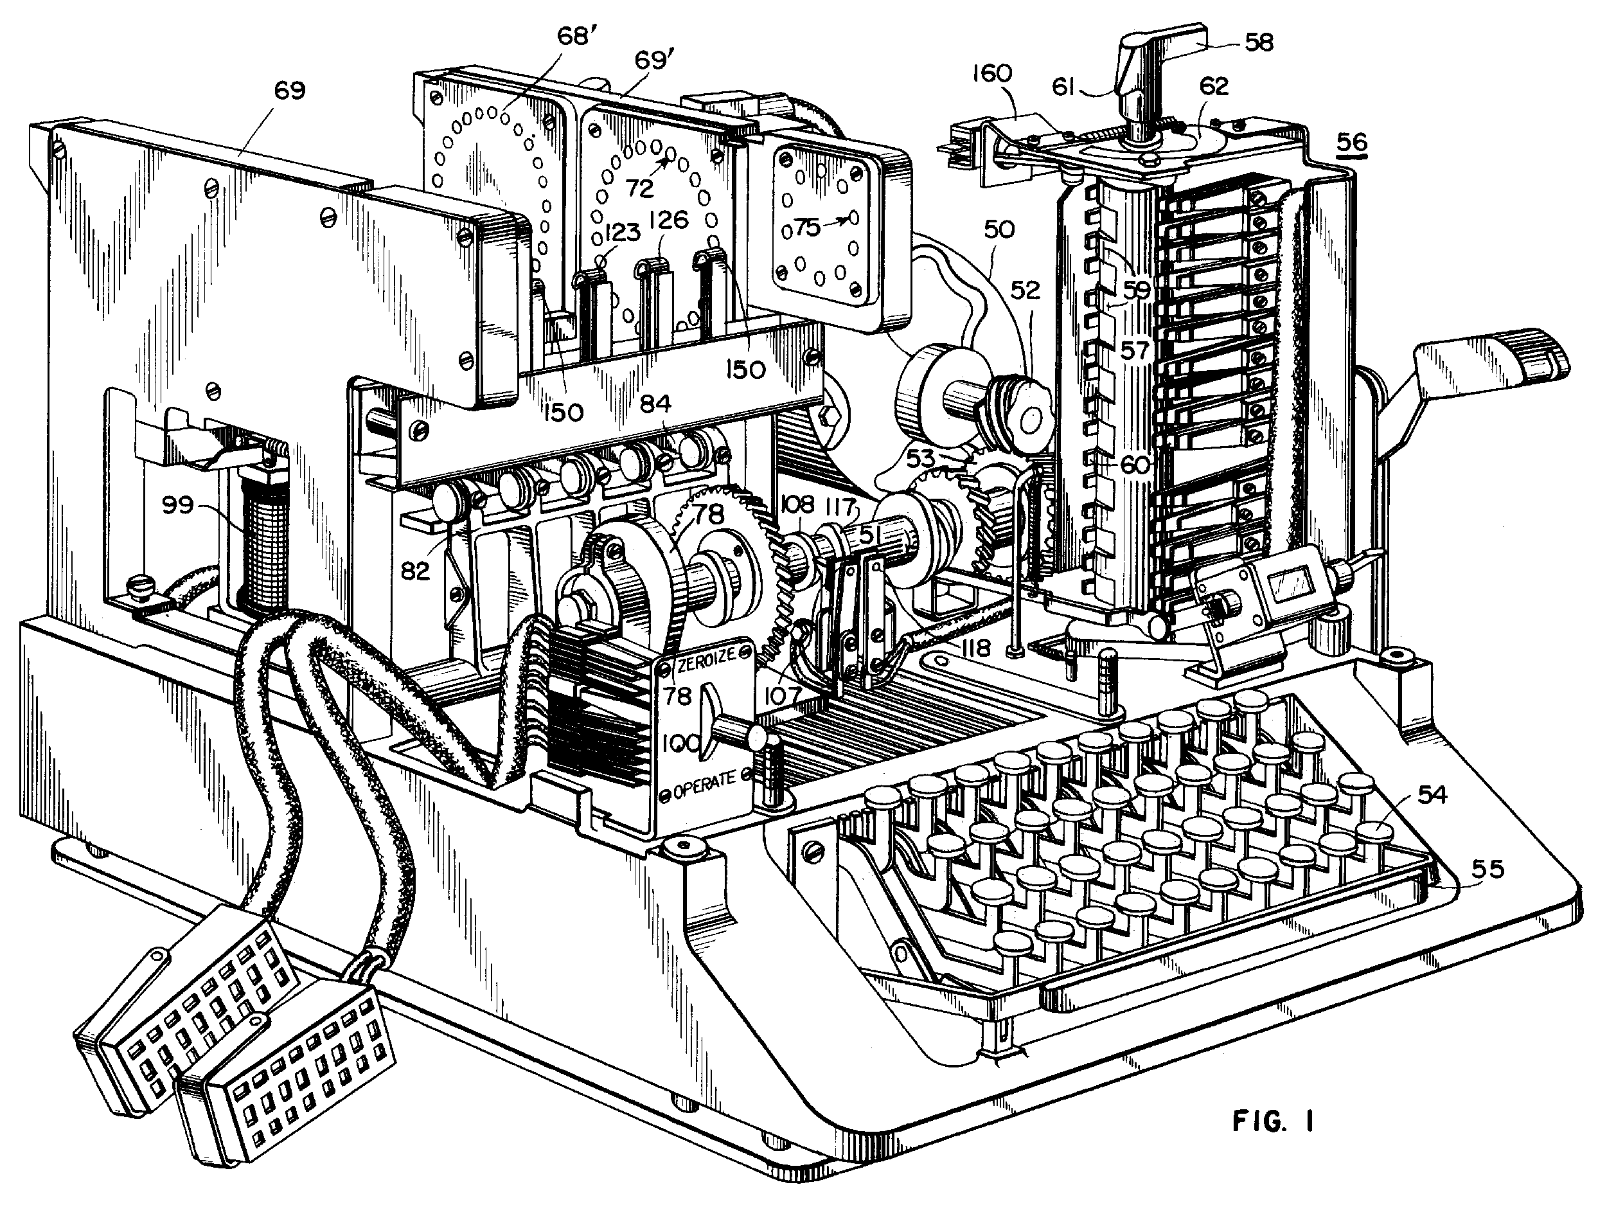
What is cognition?

Slide 10
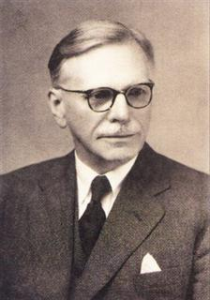
“You shall know a word by the company it keeps”
- John Firth, 1957

Slide 11

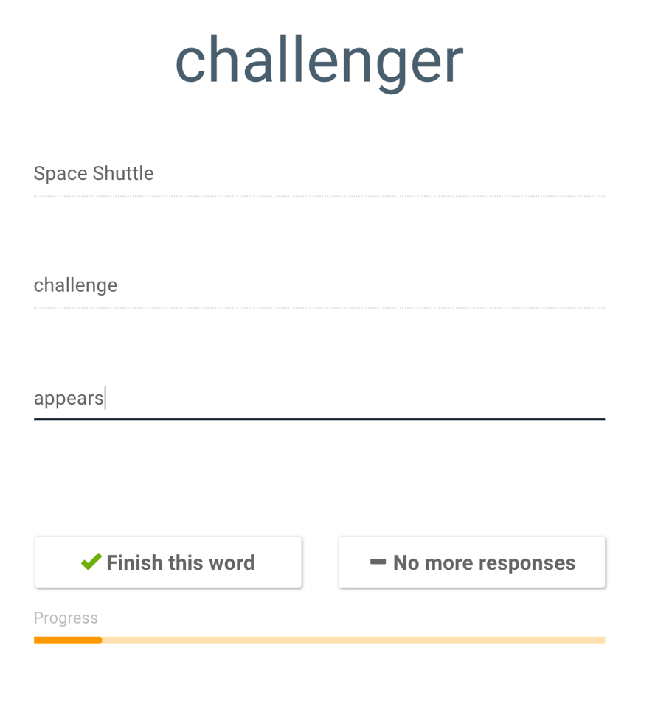
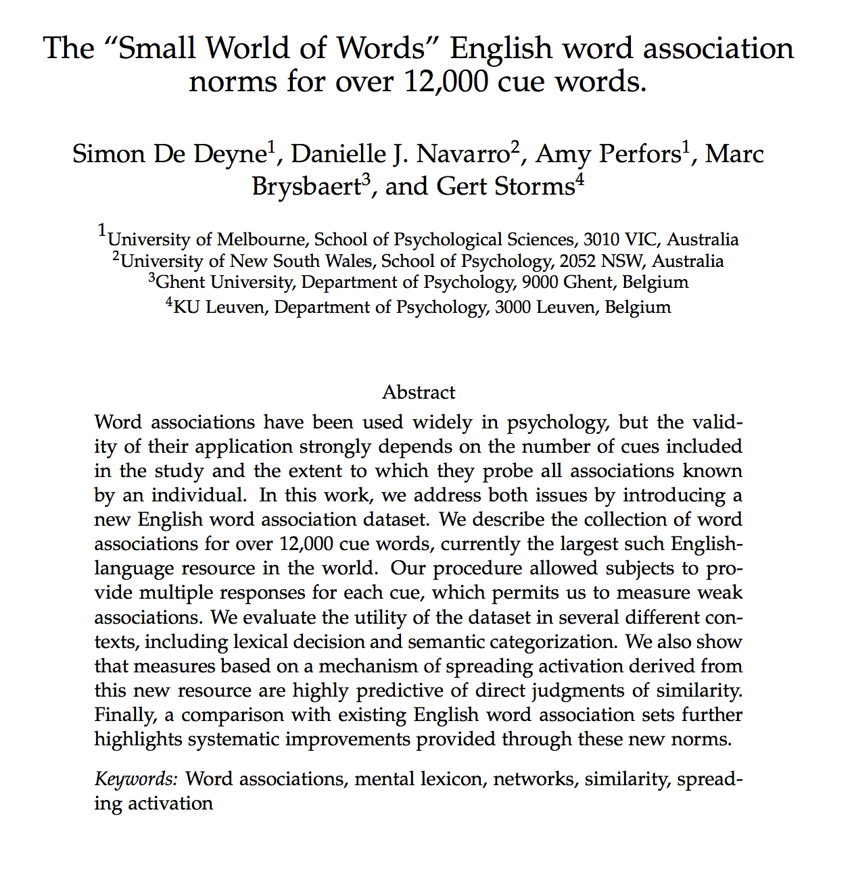
https://smallworldofwords.org/en/project/home

Slide 12
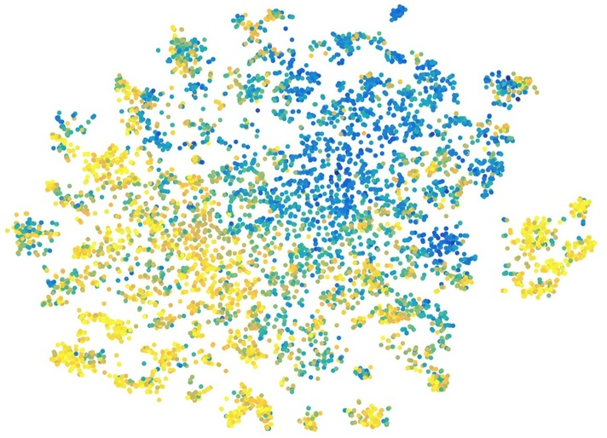
https://smallworldofwords.org/en/project/home

Slide 13
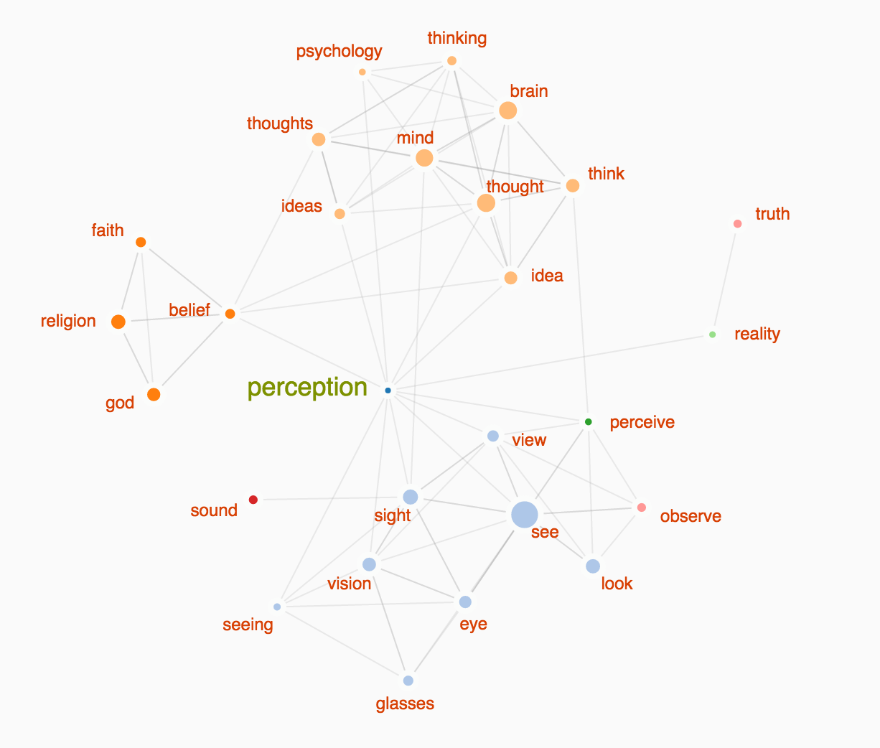
Minds
Sensation

Slide 14
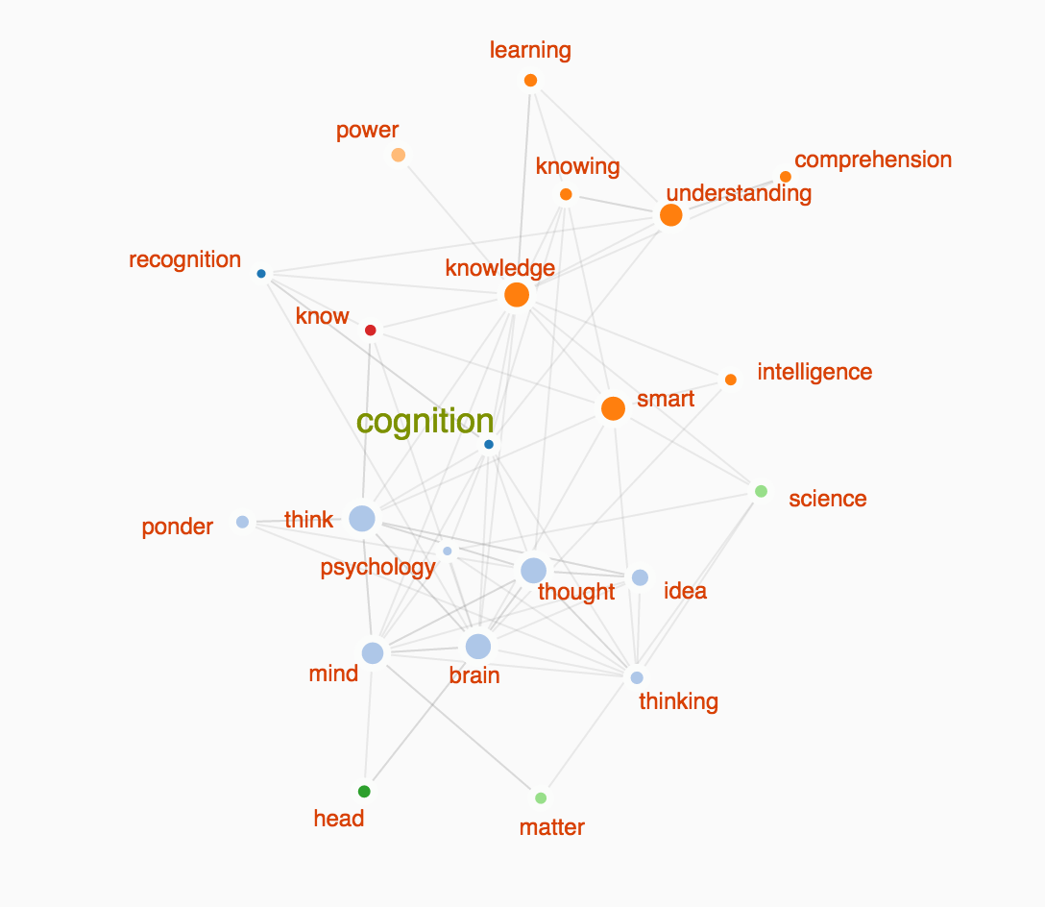
Knowledge
Minds

Slide 15

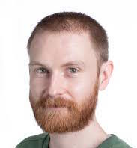

Perception is concerned with how the mind interprets sensory data
Cognition is concerned with knowledge, reasoning, memory, language, decision making, etc

Slide 16
Historical context

Slide 17
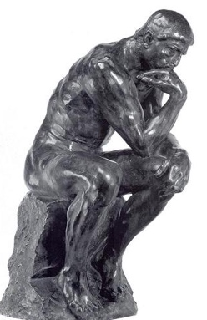
Founded the first experimental psychology lab in 1897 at the University of Leipzig
I’m bored!
Wilhelm Wundt
Used the method of introspection… subjective observation of one’s own experiences

Slide 18
Behaviourist critique
“Psychology as the behaviorist views it is a purely objective experimental branch of natural science. Its theoretical goal is the prediction and control of behavior. Introspection forms no essential part of its methods, nor is the scientific value of its data dependent upon the readiness with which they lend themselves to interpretation in terms of consciousness. The behaviorist, in his efforts to get a unitary scheme of animal response, recognizes no dividing line between man and brute.”
- John Watson, 1913, “Psychology as a behaviorist views it”

Slide 19
Behaviourist principles
Methodological: Psychological theories should be based on observable empirical data
“…psychology as a behaviorist views it is a purely objective experimental branch of natural science. Its theoretical goal is … prediction and control” (Watson, 1913, p. 158).
Theoretical: Behaviour is best understood in terms of stimulus-response associations.
“[The aim of Behaviorism is…] To predict, given the stimulus, what reaction will take place; or, given the reaction, state what the situation or stimulus is that has caused the reaction” (Watson, 1930, p. 11).
The latter is now commonly referred to as “Radical Behaviorism”

Slide 20
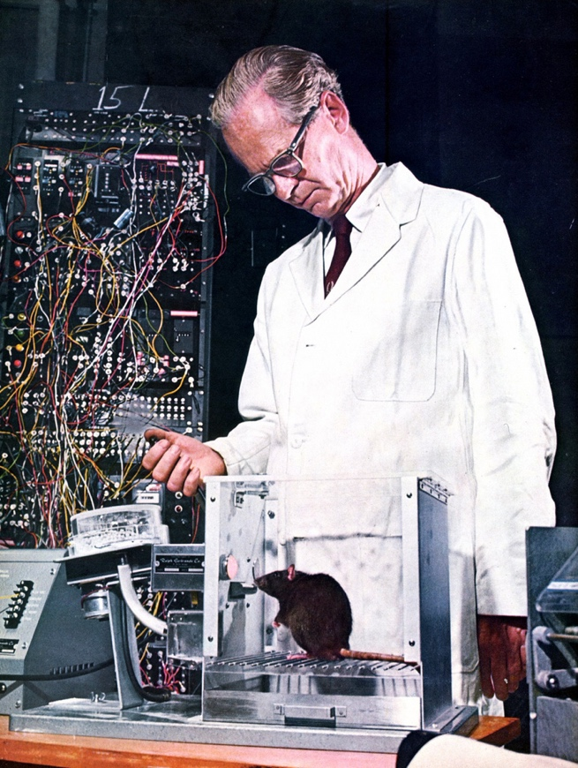
Behaviourist successes
New methods & practices
An understanding developed of how animals (and humans) learn certain new behaviours. i.e. conditioning
Psychological theories became testable and falsifiable.
Huge implications for the clinic
Skinner and “his box”

Slide 21

Limits of (radical) behaviourism
S-R contingencies impose very strong constraints
Hard to study these…
Form an opinion
Pay attention to red
Have an intention
Plan a holiday
Write an essay
Etc.

Slide 22
Example – language production
Language has “non-adjacent dependencies”… very hard to describe in terms of S-R contingencies
The car that I saw yesterday is yellow
The cars that I saw yesterday are yellow
Chomsky’s scathing review of Skinner’s Verbal Behavior was influential
Constraint
“Markov chain” models of language that produce text by chaining together S-R contingencies are pretty hilarious…

Slide 23
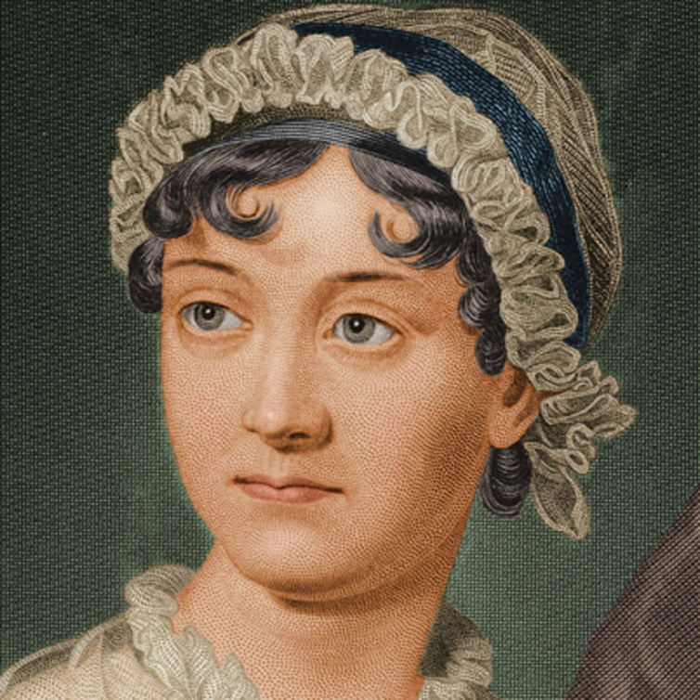
Example – language production
"Come, Darcy," said he, "I must have you dance. I hate to see you standing about by yourself in this stupid manner. You had much better dance."
"I certainly shall not. You know how I detest it, unless I am particularly acquainted with my partner. At such an assembly as this it would be insupportable. Your sisters are engaged, and there is not another woman in the room whom it would not be a punishment to me to stand up with."
- Jane Austen, Pride & Prejudice

Slide 24
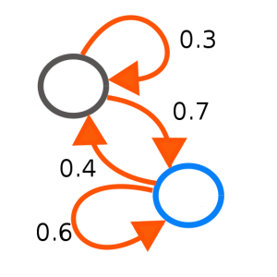
Example – language production
"Come, Darcy," said he, "I must have occasion to write in the opposite corner, saw it all with great intrepidity: "Miss Elizabeth Bennet."
"Miss Elizabeth Bennet!" repeated Miss Bingley. "I am not particularly speaking of such a man really is by the possessor, and often without any attention to herself, she was welcomed by her sister allowed it to you? Mr. Robinson's asking him how he liked our Meryton assemblies, and that you are the youngest, I'm the tallest."
- A simple “response chaining” model trained on Pride and Prejudice
https://ermarian.net/services/converters/markov/words

Slide 25
The cognitive revolution

Slide 26

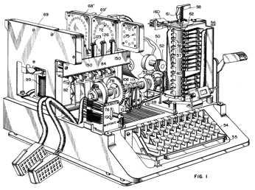
???
(Radical) behaviourism ... the contents of mind are unobservable therefore off-limits to science
?
Cognitivism … the mind is a kind of unknown biological machine, and scientists may propose theories about its structure

Slide 27
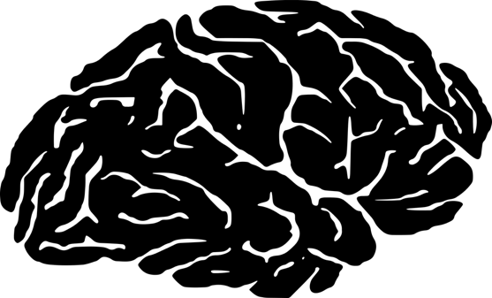
What kind of machine is a mind? The computational metaphor

Slide 28
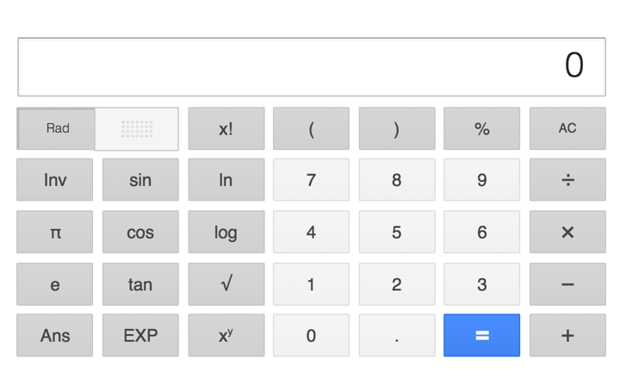
Information processing machines
Stimulus:
14 x 4
Response:
56
Process:
x 4 = (x2 x2)
14 + 14 = 28
28 + 28 = 56

Slide 29
Empirically testable predictions?
Speed?
x6 should take longer to perform than x4
Accuracy?
If each step is noisy we should also see more errors
Process:
x 4 = (x2 x2)
14 + 14 = 28
28 + 28 = 56

Slide 30
Cognitive psychology as a computationalist views it
“Information processing”
The computational metaphor suggests that we can use the language of “computing” to build “models”
Why do this?
Computational language is precise… we can generate empirically testable predictions (see: methodological behaviourism!)
Computational language is flexible... so we can postulate hidden mechanisms and structure to cognitive processes (goes beyond radical behaviourism)

Slide 31
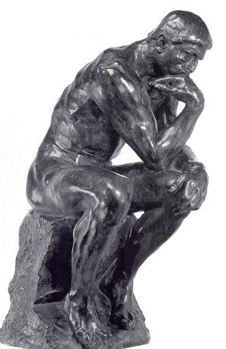
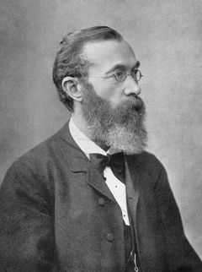
Measuring cognition?
Common methods
Accuracy of response
Type of response
Response time
Neurological deficit
Brain imaging
Self-report
“hey…”

Slide 32
Is computation special?

Slide 33
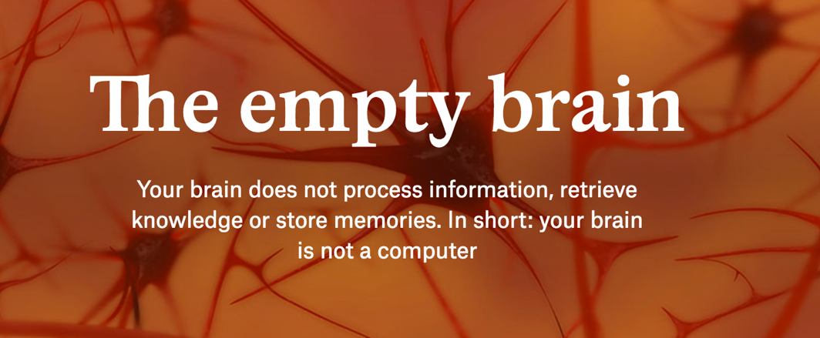
https://aeon.co/essays/your-brain-does-not-process-information-and-it-is-not-a-computer
Robert Epstein
“Our shoddy thinking about the brain has deep historical roots, but the invention of computers in the 1940s got us especially confused. For more than half a century now, psychologists, linguists, neuroscientists and other experts on human behaviour have been asserting that the human brain works like a computer.”

Slide 34
“Computers, quite literally, process information – numbers, letters, words, formulas, images. The information first has to be encoded into a format computers can use, which means patterns of ones and zeroes (‘bits’) organised into small chunks (‘bytes’). On my computer, each byte contains 8 bits, and a certain pattern of those bits stands for the letter d, another for the letter o, and another for the letter g. Side by side, those three bytes form the word dog.”
- Robert Epstein

Slide 35

- Danielle Navarro
Okay, let’s take a closer look…

Slide 36
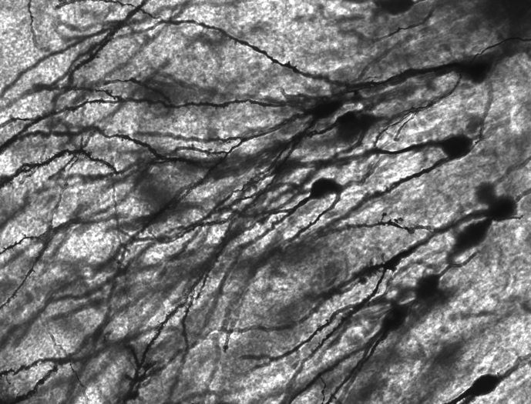
A superficial interpretation of the computational metaphor: these two machines are very similar to each other.
This claim is obviously wrong

Slide 37

“Intelligent Machinery”
Alan Turing

Slide 38
Turing machines
A Turing machine is a very simple (hypothetical) device that reads and writes symbols off a piece of tape…
… yet it is a universal computing machine. Anything that can be computed, can be computed with this machine*
(*Sort of)

Slide 39
Digital computers are much fancier versions of Turing machines

Slide 40
But you can build a universal computing machine out of lego

Slide 41
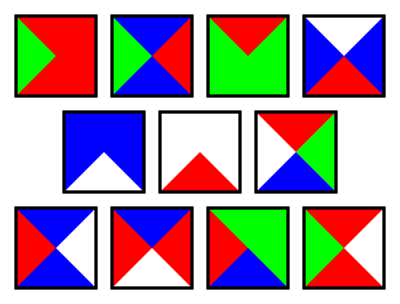
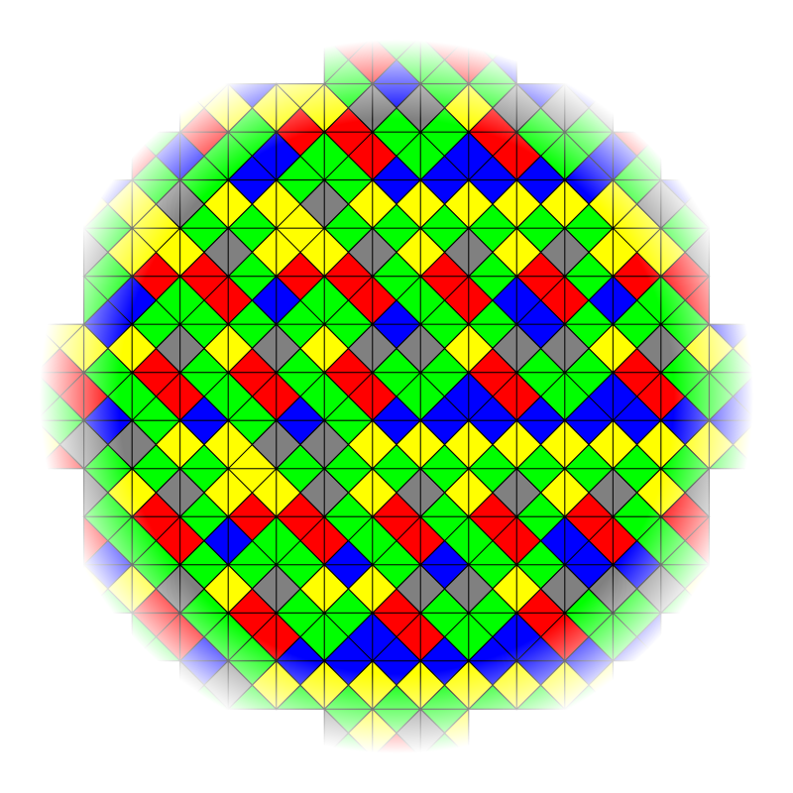

You can use “Wang tiles” on your bathroom floor …
… and these tiles also describe a universal computing machine

Slide 42
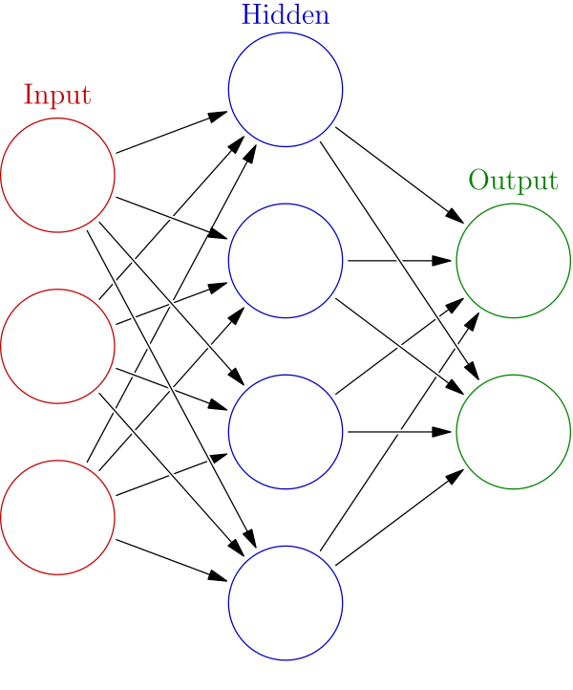

“Neural networks” describe an information processing system that is inspired by the structure of the brain
These are also universal computing machines

Slide 43

A “program” given to one universal Turing machine can be rewritten using the language of another universal Turing machine
At a fundamental level what underpins the computational metaphor is the fact that these are all information processing machines ... they are computers

Slide 44
“The laptop fallacy”
My bathroom floor doesn’t look very much like my laptop, therefore Wang tiles do not describe a computing machine?

Slide 45

“The laptop fallacy”
My brain doesn’t look very much like my laptop, therefore the human mind is not a computing machine?

Slide 46
Example: learning models used by behaviourists are computational models

Slide 47
Verbal description
“The more surprised an animal is, the more it will learn”
Mathematical description
update <- function(V, a, b, l) {
surprise <- l - sum(V)
dV <- a * b * surprise
return(V + dV)
}
Computational description
http://compcogscisydney.org/psyr/programming.html

Slide 48
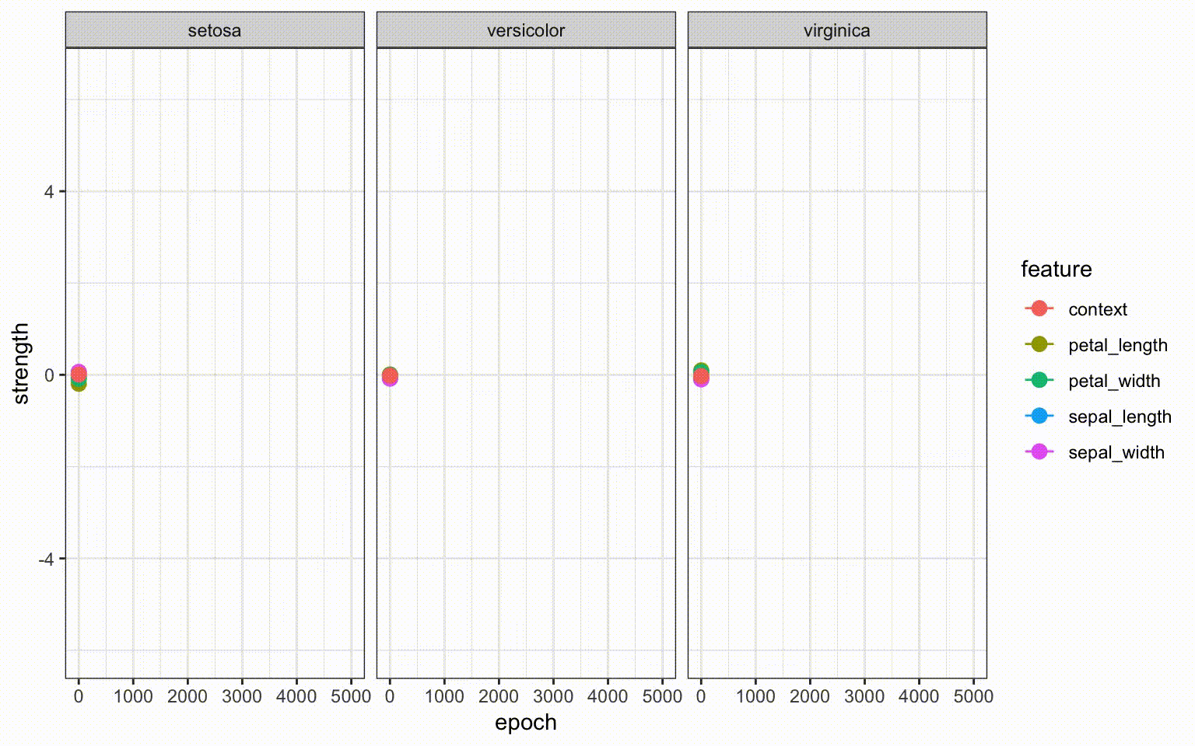
http://compcogscisydney.org/psyr/backprop.html

Slide 49
Levels of explanation

Slide 50

Cognition is performed by the brain, and our theories of cognition should informed by the biology of the brain

Slide 51


Cognition is a feature of intelligent agents, and our theories of cognition should be informed by understanding what intelligent agents do

Slide 52
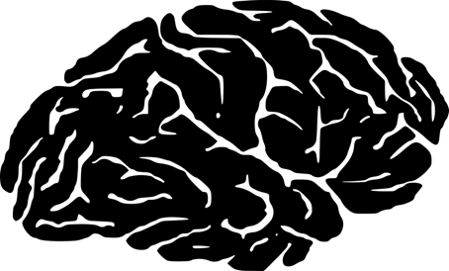
Agreement?
At an abstract level, cognition is a form of computation, and the brain does information processing

Slide 53
Disagreement?
What mechanisms does the brain use to perform computations?
What computational problems does the mind solve?

Slide 54
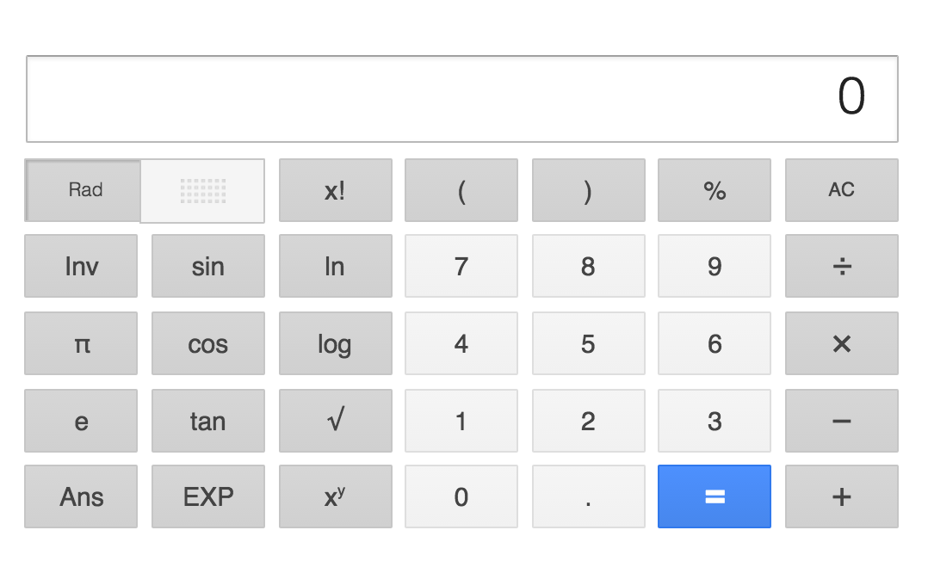
Describing the tension: Marr’s “levels of analysis”
Abstract computation: What problem does cognition solve?
Algorithm: What processing steps does it follow to do so?
Implementation: How is this instantiated as a physical entity?
(Marr 1980)

Slide 55
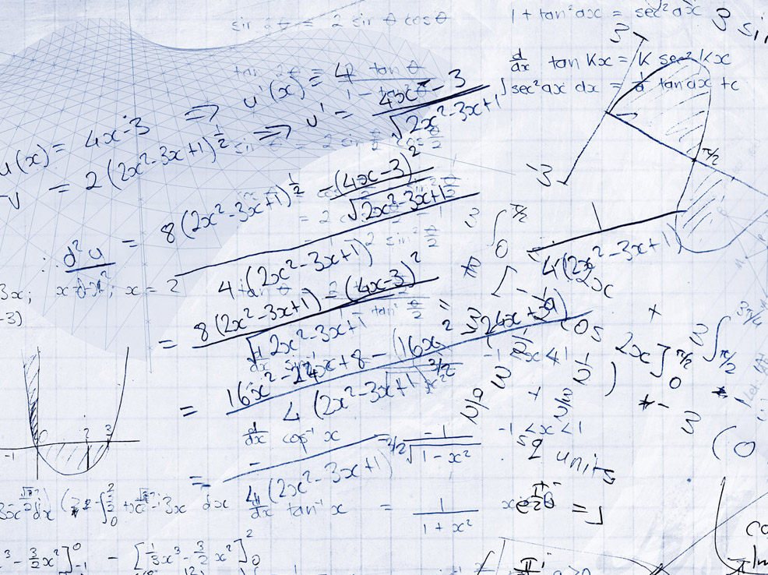
The computational level
“The function of a calculator is to solve arithmetic problems”

Slide 56

The algorithmic level
“Addition can be described using a computer program”

Slide 57
The implementation level
“A calculator uses circuitry to do calculations”

Slide 58
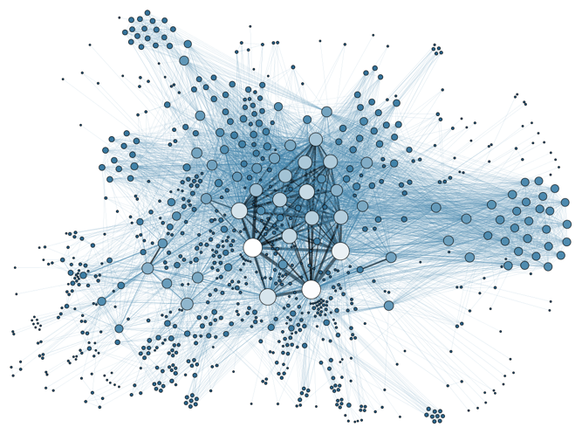

Machine learning
Computation
Statistics
Computer science
Algorithm
Psychology
Cognitive science
Neuroscience
Implementation
Biology

Slide 59
What have we covered?
The relationship between perception and cognition
Behaviourism as a response to introspection
Failures of the behaviourist view
The computational metaphor
Discussion of what “computation” means
Discussion of Marr’s levels of analysis

Slide 60
